Slide 1
Neural Networks

Slide 2
Human Brain
Computers and the Brain: A Contrast
  Arithmetic: 1 brain = 1/10 pocket calculator
  Vision: 1 brain = 1000 super computers
  Memory of arbitrary details: computer wins
  Memory of real-world facts: brain wins
  A computer must be programmed explicitly
  The brain can learn by experiencing the world

Slide 3
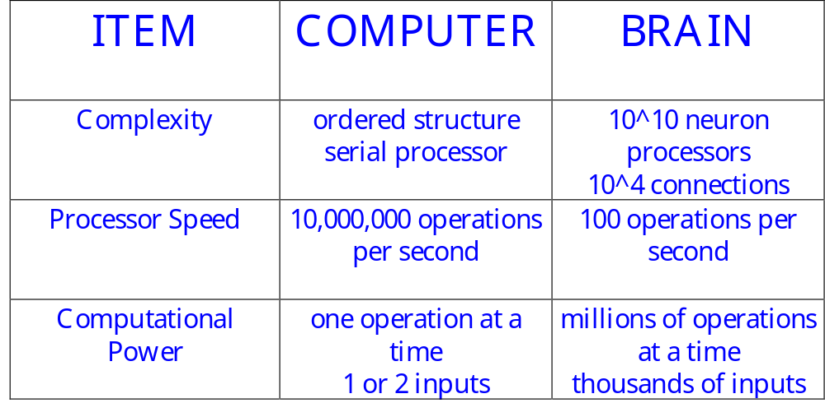
Other Comparisons

Slide 4
Computer Operations
Traditionally computers execute a sequence of instructions to accomplish a set task
    This is a powerful technique if you know the ‘algorithm’
    It’s not very useful if you don’t !!
There are many interesting tasks where the algorithm is either unknown or unclear
    Recognizing handwriting - Pattern recognition
    Playing table tennis - Interacting with the environment
    Balancing activities - Optimization

Slide 5

The Question
  Humans find these tasks relatively simple
    We learn by example
    The brain is responsible for our ‘computing’ power
If a machine were constructed using the fundamental building blocks found in the brain could it learn to do ‘difficult’ tasks ???

Slide 6
Definition
“. . . Neural nets are basically mathematical models of information processing . . .”
“. . . (neural nets) refer to machines that have a structure that, at some level, reflects what is known of the structure of the brain . . .”
“A neural network is a massively parallel distributed processor . . . “

Slide 7
Neural Net Concept
Artificial Neural Systems are called:
  neurocomputers
  neural networks
  parallel distributed processors
  connectionists systems
Basic Philosophy
  large number of simple “neuron-like” processors which execute global or distributed computation

Slide 8
Neural Nets vs Standard Computing
NN are different from
  Parallel Processors - if you look at one processor in a typical parallel system, its work makes sense
  Contemporary AI – no algorithms

Slide 9
Processing Comparisons
INPUT
(Type)
OUTPUT
(Procedural)
Data Input
Conventional Processing
Procedures applied to data
Data Output
1, 2, 3, etc.
(Logical)
Facts
Expert/Knowledge-Based System
Inference Engine & Knowledge (Rules)
Decision Recommend
(A is True)
(Statistical)
Patterns
Neural Networks
Network Algorithm Identifies Patterns
Pattern recognized
Shashidhar Ram Joshi

Slide 10
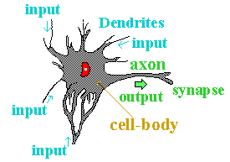
Biological Neurons
A neuron consists of two main parts:
  Axon
    one per neuron
    excites up to 10⁴ other neurons
    all or nothing output signal
  Dendrites
    1 to 10⁴ per neuron

Slide 11
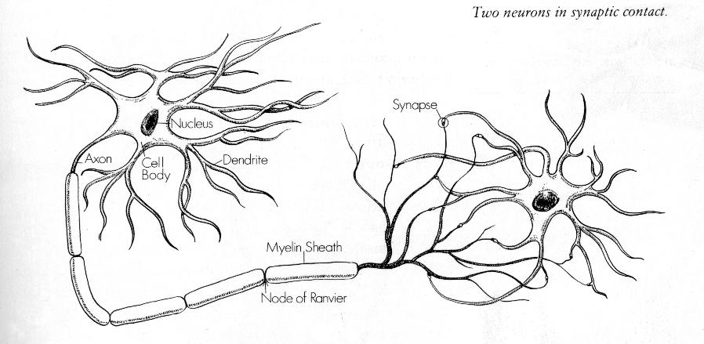
Two Neurons

Slide 12
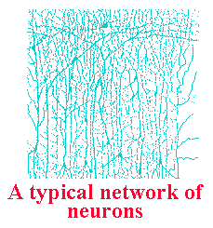
Properties of the Brain
Architectural
  80,000 neurons per square mm
  10¹¹ neurons - 10¹⁵ connections
  Most axons extend less than 1 mm (local connections)
Operational
  Highly complex, nonlinear,
  parallel computer
  Operates at millisecond speeds

Slide 13
Interconnectedness
Each neuron may have over a thousand synapses
Some cells in cerebral cortex may have 200,000 connections
Total number of connections in the brain “network” is astronomical—greater than the number of particles in known universe

Slide 14
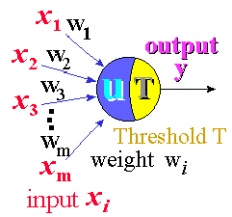
Artificial Neuron
An artificial neuron is designed to mimic the first-order characteristics of a biological neuron
A set of inputs, x_{i}
Each input is multiplied
by the corresponding
weight, w_{i}
All of the weighted inputs
are summed to determine
the activation level
An activation function is applied to determine
the neuron output

Slide 15

Mathematical Structure
A neuron is a simple sum and compare device
u = x₁w₁ + x₂w₂ + . . . x_{n}w_{n} - T
y = f(u)
threshold
One possible function for y is a step function:
If the weighted sum of the inputs is greater
than the threshold, then the neuron “fires”

Slide 16
OUTLINE
Features of Neural Nets
Learning in Neural Nets
McCulloch/Pitts Neuron
Hebbian Learning

Slide 17
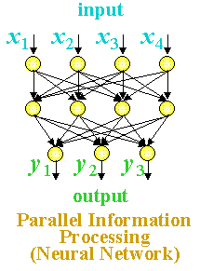
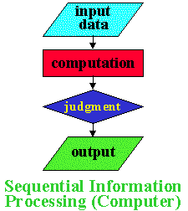
Features of Neural Nets
Neural Net Characteristics 1
Neural nets have many unique features:
Massive Parallel Processing:
Neural Nets update in parallel
Computers calculate in sequence

Slide 18
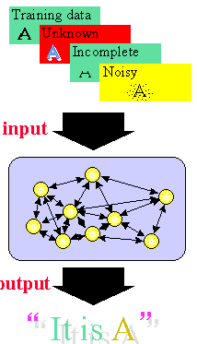
Neural Net Characteristics 2
Neural nets can learn:
Once a neural net is trained, it can handle unknown, incomplete or noisy data

Slide 19
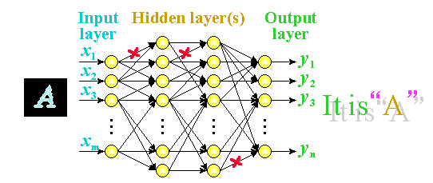
Neural Net Characteristics 3
Unlike computer memory, information is distributed over the entire network, so a failure in one part of the network does not prevent the system for producing the correct output.

Slide 20
Learning in Neural Nets
One of the powerful features of neural networks is learning.
Learning in neural networks is carried out by adjusting the connection weights among neurons.
It is similar to a biological nervous system in which learning is carried out by changing synapses connection strengths, among cells.
Learning may be classified into 2 categories:
(1) Supervised Learning
(2) Unsupervised Learning

Slide 21
OUTLINE
Introduction to Learning
Learning Methods
Introduction to Learning by Induction

Slide 22
Introduction to Learning
Learning
Learning is one of those everyday terms which is broadly and vaguely used in the English language
  Learning is making useful changes in our minds
  Learning is constructing or modifying representations of what is being experienced
  Learning is the phenomenon of knowledge acquisition in the absence of explicit programming

Slide 23
Learning is . . .
Learning involves the recognition of patterns in data or experience and then using that information to improve performance on another task

Slide 24
Implications
Learning involves 3 factors:
Learning changes the learner: for machine
learning the problem is determining the nature
of these changes and how to best represent them
changes
Learning leads to generalization: performance
must improve not only on the same task but on
similar tasks
generalization
Learning leads to improvements: machine
learning must address the possibility that
changes may degrade performance and find ways
to prevent it.
improvement

Slide 25
Learning Methods
There are two different kinds of information processing which must be considered in a machine learning system
  Inductive learning is concerned with determining general patterns, organizational schemes, rules, and laws from raw data, experience or examples.
  Deductive learning is concerned with determination of specific facts using general rules or the determination of new general rules from old general rules.

Slide 26
Learning Framework
There are four major components in a learning system:
Performance
Element
Environment
Learning
Element
Knowledge
Base

Slide 27
The Environment
The environment refers the nature and quality of information given to the learning element
The nature of information depends on its level (the degree of generality wrt the performance element)
  high level information is abstract, it deals with a broad class of problems
  low level information is detailed, it deals with a single problem.
The quality of information involves
  noise free
  reliable
  ordered

Slide 28
Learning Elements
Four learning situations
  Rote Learning
    environment provides information at the required level
  Learning by being told
    information is too abstract, the learning element must hypothesize missing data
  Learning by example
    information is too specific, the learning element must hypothesize more general rules
  Learning by analogy
    information provided is relevant only to an analogous task, the learning element must discover the analogy

Slide 29
Knowledge Base
Expressive
  the representation contains the relevant knowledge in an easy to get to fashion
Modifiable
  it must be easy to change the data in the knowledge base
Extendibility
  the knowledge base must contain meta-knowledge (knowledge on how the data base is structured) so the system can change its structure

Slide 30
Performance Element
Complexity
  for learning, the simplest task is classification based on a single rule while the most complex task requires the application of multiple rules in sequence
Feedback
  the performance element must send information to the learning system to be used to evaluate the overall performance
Transparency
  the learning element should have access to all the internal actions of the performance element

Slide 31
Supervised Learning
In supervised learning, the network is presented with inputs together with the target (teacher signal) outputs.
Then, the neural network tries to produce an output as close as possible to the target signal by adjusting the values of internal weights.
The most common supervised learning method is the “error correction method”

Slide 32
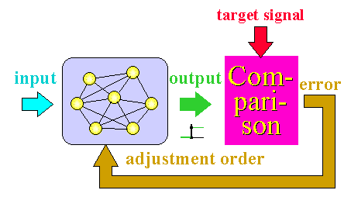
Error Correction Method
Error correction method is used for networks which their neurons have discrete output functions.
Neural networks are trained with this method in order to reduce the error (difference between the network's output and the desired output) to zero.

Slide 33
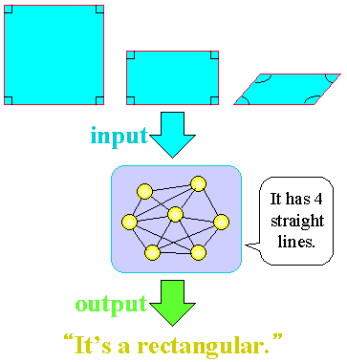
Unsupervised Learning
In unsupervised learning, there is no teacher (target signal) from outside and the network adjusts its weights in response to only the input patterns.
A typical example of unsupervised learning is
Hebbian
learning.

Slide 34
Common NN Features
“weight” = strength of connection
threshold = value of weighted input below which no response is produced
signals may be:
  real-valued, or
  binary-valued:
    “unipolar” {0, 1}
    “bipolar” {-1, 1}

Slide 35
NN Development
Define Problem
There is no single methodology for NN development
  A suggested approach is:
Data Selection,
Preparation,
Preprocessing
Determine Best-Suited
Algorithm
Train Network
Trained
Successfully?
Test Network
Tested
Successfully?
Run/Use Network

Slide 36
Learning in Neural Nets (again)
The operation of a neural network is determined by the values of the interconnection weights
  There is no algorithm that determines how the weights should be assigned in order to solve a specific problems
  Hence, the weights are determined by a learning process

Slide 37
The Perceptron
Introduction to the Perceptron
OUTLINE
b
The perceptron was suggest by Rosenblatt in 1958.
It uses an iterative learning procedure which can be proven to converge to the correct weights for linearly separable data
It has a bias and a threshold function
b
x₁
w₁
Σ
Θ
w₂
x₂
Activation function:
{
f(s) =
1 if s > Θ
0 if -Θ <= s <= Θ
-1 if s < -Θ

Slide 38
Perceptron Learning Rule
Weights are changed only when an error occurs
The weights are updated using the following:
w_{i}(new) = w_{i}(old) + αtx_{i}
t is either +1 or -1
α is the learning rate
If an error does not occur, the weights are
not changed

Slide 39
Limitations of the Perceptron
    The perceptron can only learn to distinguish between classifications if the classes are linearly separable.
    If the problem is not linearly separable then the behaviour of the algorithm is not guaranteed.
    If the problem is linearly separable, there may be a number of possible solutions.
    The algorithm as stated gives no indication of the quality of the solution found.

Slide 40
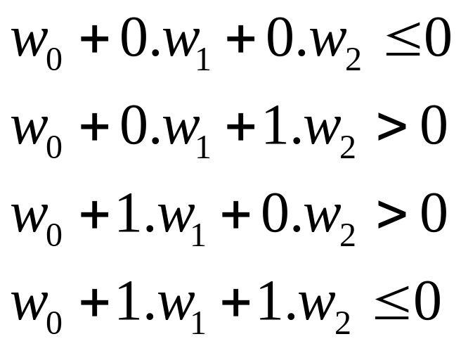
XOR Problem
A perceptron network can not implement an XOR function
o(x₁,x₂)
w₀
w₂
XOR(x₁,x₂)
w₁
INPUTS ARE DIFFERENT – 1 OUT
x₀ x₁ x₂
There is no assignment of values to w₀,w₁ and w₂ that
satisfies above inequalities. XOR cannot be represented!

Slide 41
MultiLayer Perceptrons
Perceptrons can be improved if placed in a multilayered network
Input
Layer
Hidden Layers
ϕ
ϕ
Output
Layer
x₁
1
ϕ
ϕ
ϕ
y₁
Inputs
x₂
1
Outputs
ϕ
ϕ
ϕ
y₂
x₃
1
w_{kl}
w_{ij}
ϕ
ϕ
w_{jk}

